Slide 1
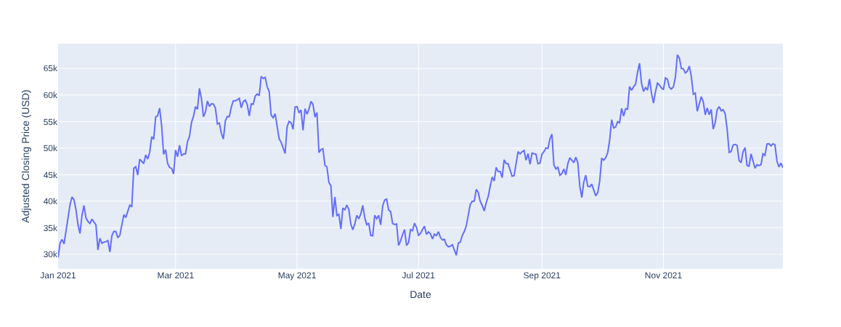
Data Set
Bitcoin Twitter Data
  Bitcoin related tweets
  Complete 2021
  15,6 million Tweets
  Over 2 million Users
  No Metainformation
  Users, No Labels
Bitcoin Historical Data
  1-min interval Bitcoin-Price
  Open, close, high, low, volume (We used close)
Bitcoin Chart 2021
Notes:
In order to do that we Analyse more than 1 million bitcoin tweets by .ca 200k users from Feb 2021 to August 2021
And we will the BTC data in the same time period. As you can see it does a nice rollercoaster movement.
Daniel will share further details about the analysis

Slide 2
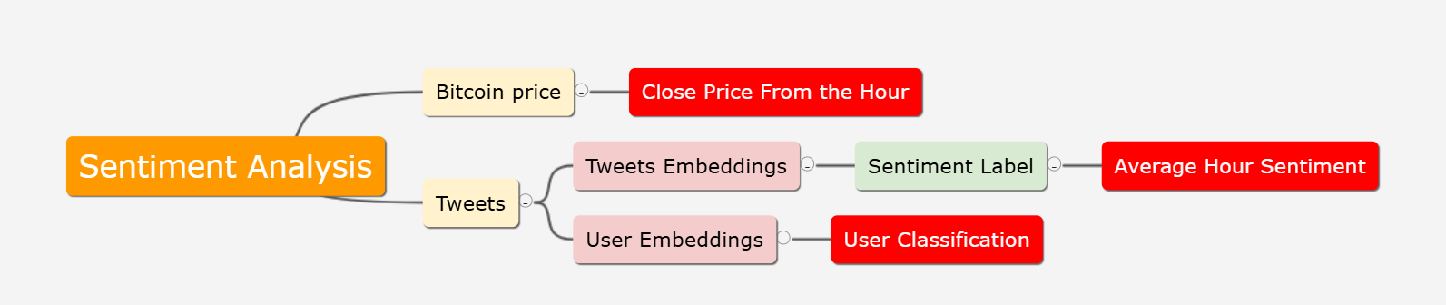
Sentiment analysis pipeline

Slide 3
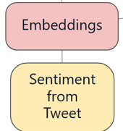
The label pipeline
Embeddings:
  Roberta
Labeling
  Since the Data is not Labeled
  Pre Trained Model for Twitter
  twitter-roberta-base-sentiment-latest
  Labels: { negativ, positive, neutral}

Slide 4
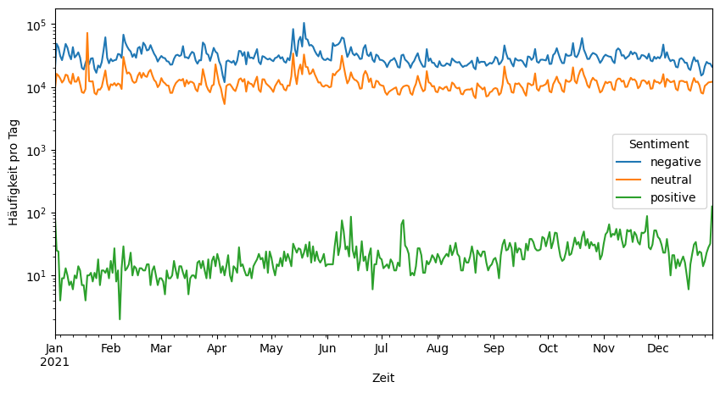
Timeline of embeddings labels

